Slide 1

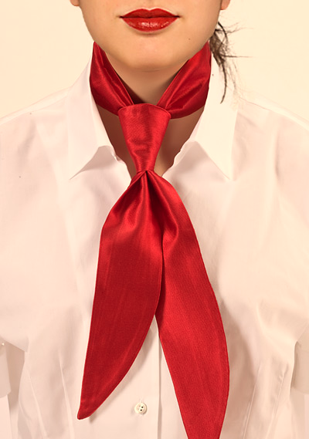
Tailleur and a Tie (T&T)
Profiling Women Leaders
Presented by
Magued (Mag) Wassef, MBA, PMP
Project Management Consultant & Founder – MCP Consulting Inc. Canada
&
Dr.Nehal El Naggar
Assistant Professor – Royal University for Women (RUW)

Slide 2
Agenda
Profiles
Analysis
Significance
Methodology
Objectives
Problem
Overview
Notes:
Overview: Women in Business
Research Problem
Research Objectives
Research Significance
Research Methodology
Research Analysis
Women Leader Profiles
Conclusion
Recommendations

Slide 3
Overview: Women In Business
In today's world, female representation in all aspects of life (professional, volunteer, even household) can no longer be overlooked or marginalized
Yet in some areas there are still old-fashioned taboos, customs, stereotypes, traditions, and cultural influences that are still governing the society.
Social, Cultural and Organizational factors
We can still hear top level executives saying
“Since women can’t handle the pressure, we had to turn to a gentleman instead!”

Slide 4
Women in S&P 500 Companies

Slide 5
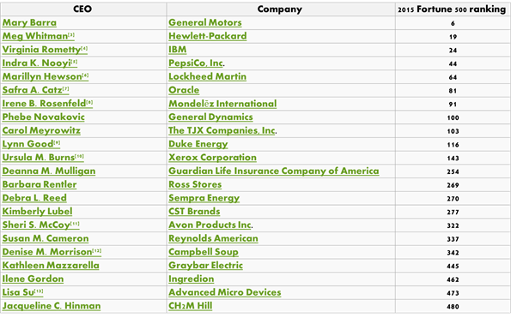
Fortune 500 (22 CEOs) in 2015
Notes:
Women currently hold 4.4 percent of Fortune 500 CEO roles. They are not evenly distributed; top Fortune 100 companies ( eight female CEOs (8%), while the remaining Fortune 500 companies have 14 female CEOs (3.5%).

Slide 6
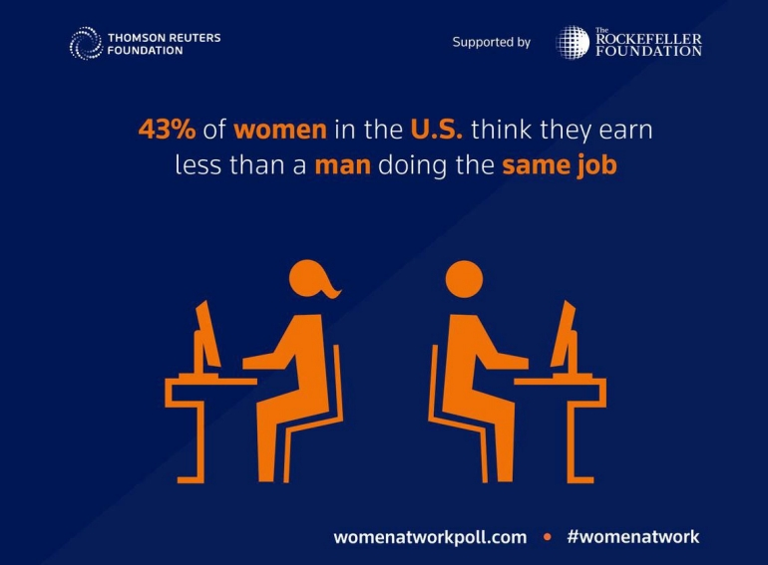

Slide 7
Research Problem
High-potential women advance more slowly than their male peers, in terms of both career progression and pay, even though they employ career management strategies similar to men’s
There is a lack of understanding of the main reasons behind keeping women out of the corner office and not allowing them to pass the glass ceiling to join the same track as their male peers.

Slide 8
Research Objectives
The main objective of this research is to reveal some challenges facing women where career choices for women are limited.
To make valid recommendations to young ladies, fresh graduates and future leaders from real life experiences.

Slide 9
Research Significance
The significance of studying the main reasons for women to stay in the workforce and to develop to qualify for future senior positions. Moreover, the fact that stereotyping females affects women’s self-perception and under-estimation in most incidence.
The increase of Diversity requirements mandated by International Organizations, Countries and Governments.
The Equal Employment Opportunity Act 1972
United Nations Millennium Development Goals (MDGs): Goal 3 To PROMOTE GENDER EQUALITY AND EMPOWER WOMEN with the Target 3.A:
  Eliminate gender disparity in primary and secondary education, preferably by 2005, and in all levels of education no later than 2015

Slide 10
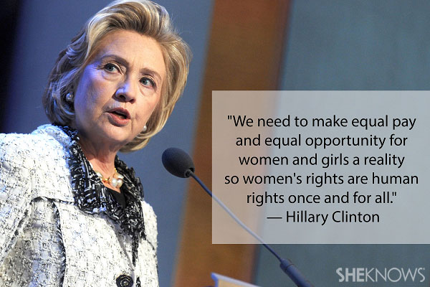

Slide 11
Research Methodology
This is a qualitative exploratory research presenting the case study of women leaders in senior managerial positions.
The targeted sample included all women working in managerial positions in Middle, Upper middle and senior levels.
A Qualitative survey has been collected from 23 females respondents
The profile of four successful women leaders has bben assessed qualitatively

Slide 12
Descriptive Data Analysis
All 23 respondents provided their consent to participate in the survey. Sample of their titles are as follows
Manager, Marketing & PR Department
Senior Director, Global Business Development
HR specialist
Relationship manager
deputy manager
Senior supervisor
Deputy manager
Medical director
Training manager
Media coordinator
Director of certified programs
MD
Direct Sales Manager
Executive
Brand manager/Chief of staff
Vice President Marketing Package Solution Consultant
Marketing manager
Manager
consultant

Slide 13
Descriptive Analysis…cont’d

Slide 14
Age

Slide 15
Years of Experience

Slide 16
Cultural Effect

Slide 17
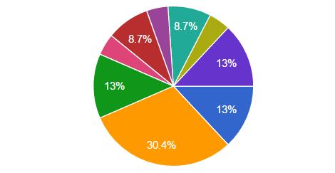
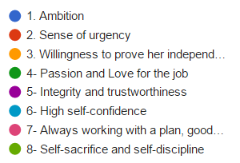
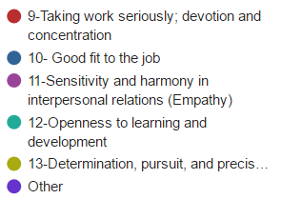
Female Characteristics

Slide 18
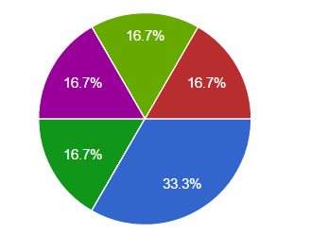
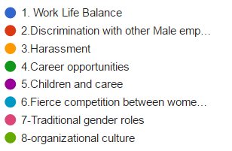

Challenging Factors

Slide 19
Enabling Factors

Slide 23
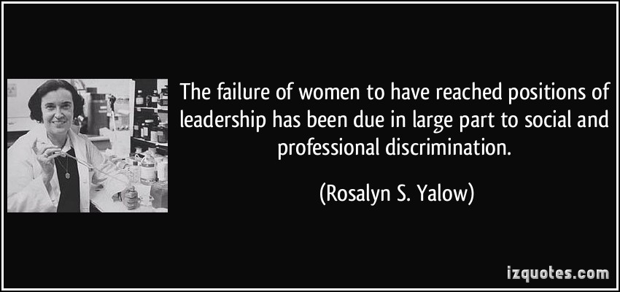

Slide 24
Testimonials
One of the women leaders stated, “I have always seen my mom as an excellent wife and Mother but she was too submissive to make decisions and/or change decisions even for her own self-interest. Early on my life and career, this made me doubt my own personal abilities thinking I’d always be like my mom even at work, and it was definitely a self-limiting belief and a misperception as by time I have learned how to stand up for myself and it took me where I am now, a leader and a decision-maker in a large organization and it even helped me in my personal life. So my advice to any female is to have a clear vision, pursue it and believe in herself.”

Slide 25
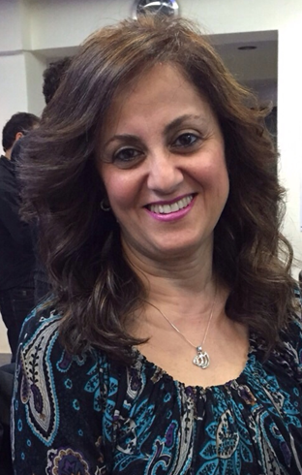
Amany Shehata
Human Resources Solution & Transformation Lead EEMEA, Mondelez International, UAE, Food Production
Amany joined current employer, Mondelēz International, in Mashreq & Algeria on 2011 Amany set up
new ways of working through an organizational redesign that enabled a smooth transition and business
continuity. Via a full, transformation journey and culture building, Amany in her current capacity has helped achieve the global Mondelez International goal of being a great place to work.
Amany started her career in the sales and Marketing domain, at Le Meridian hotel in Cairo in the Sales & Marketing Department till she reaches the deputy to the Director of Sales & Marketing and sales capability building.
In a very high shift in career, she moved to more in depth within the Development & HR, Amany moved to ProMark (Management & HR consultants) as Business Development & Operations Director, where she developed training activities in the Middle East and beyond, and helped open markets. Amany had a significant role in the talent acquisition and sourcing arena, were she supported on full sourcing and selections campaigns for the 3 telecom companies in Egypt.
Amany has a wide exposure to different industries as Lafarge Titan Egypt where she joined them as the Group Human Resources Development Manager where she supported the implementation of a startup and turnaround strategy. Also, she worked for Pfizer Company as their HR manager for Egypt covering the BU sales field force, plant & the animal health company where she was able to manage the culture change of a company with 40 years’ experience in the Egypt,
.

Slide 26
Amany Shehata
Human Resources Solution & Transformation Lead EEMEA, Mondelez International, UAE, Food Production
Amany worked at Schneider Electric, as Human Resources & Internal Communications Director for
North & East Africa. There, she supported the company's mission and business objectives by developing and promoting HR processes and strategies, contributing positively to company results. She developed projects for junior engineers and the community through technical skills-learning in government apprentice schools, talent management, career advice and leadership competencies, in addition to the establishment of the Schneider Academy. She then joined Kraft Foods.
Amany holds a DBA in Culture transformation and change management and has a very good experience in management consultancy & training
She is a Single Mom with two Sons and a beautiful Granddaughter. Her greatest support is her mother who is a psychology professor

Slide 27
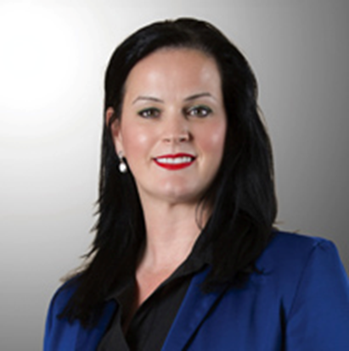
Ms.Joanne McSheffery
Chief Technology Officer, Silah Gulf
With over 15 years cross functional international experience across various domains
(IT Infrastructure Services, Telecommunications, & Virtualization), Jo O’Flynn has
extensive skills in building and leading teams to deliver world class technology solutions. She has successfully delivered solutions across many vertical markets including Banking, Finance and automotive where she has delivered numerous large-scale technology (applications & Infrastructure) deployments, demonstrating success in directing business transformations globally. Prior to working at Silah Jo was IT Manager at Merchants, a leading BPO solution provider where her role involved designing and delivering integrated Contact Centre solutions to a wide range of customers. Her previous roles also include service desk Manager at Peugeot, Cemex and FRM. Prior to this Jo was working as a lead technical engineer with hands on expertise in VOIP networks, Microsoft applications & programming. Jo has vast experience in technology and business domains and has accomplished several awards through her career including Best Contact Centre Platform in the Middle East 2012 & 2013.
As the Chief Technology Officer of an IT enabled Service Company, Jo’s role is vital for the seamless operations of the company through a robust technological backend support system, ensuring maximum client satisfaction.

Slide 28
Ms.Joanne McSheffery
Chief Technology Officer, Cont’d
As the Chief Technology Officer of an IT enabled Service Company, Jo’s role is vital for the seamless operations of the company through a robust technological backend support system, ensuring maximum client satisfaction.
She stated that women success is contingent on their ability to achieve work-life balance; she added that women with families operate with a constant guilt feeling.
Some of her words & recommendations to future women leaders were as follows:
“we all struggle to be perfect”
“I am successful because I just wanted to be noticed”
“You have to move forward to be able to achieve something”

Slide 29
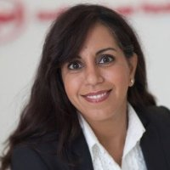
Ms.Nada AlMarhoon
Managing Director, Elite Talents for Recruitment
Managing Director at Elite Talents for Recruitment (Saudi Arabia and UAE Offices) we believe in “Empowering Saudization”
Nada AlMarhoon holds a degree from the King Saud University, as well as an international degree from Concordia University, Canada.
With 15 years of solid experience in the fields of marketing and public relations with several multinational companies across GCC, Nada has been the first Saudi female to be appointed as VP for Siemens in Saudi Arabia, with that in mind she is confident she can help Saudi professionals to achieve their goals in their careers.
Through her realization of the gap between private sectors in Saudi and qualified Saudis was the driving force behind her raising concern on Saudization matter. This is what ultimately led to her vision of establishing Elite Talents for Recruitment, focusing on recruiting qualified Saudis.
Elite Talent has managed to attain a very prestigious clients throughout different sectors in the kingdom.

Slide 30
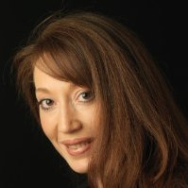
Nihal El Dali
Vice President Personal Care & Marketing Operations, Consumer Goods, Unilever, UAE
Vice President, Personal Care & Marketing Operations, Unilever (August 2015 – Present) North Africa Middle East Turkey Russia Ukraine & Belarus (NAMETRUB )
Vice President Marketing Operations, Unilever (July 2012 – 2015)
Cairo, Dubai, North Africa, Middle East, Turkey and Russia.
Director of Marketing Operations, Unilever (May 1996 – 2012)
Responsible for the NAMET RUB (North Africa, Middle East, Turkey, and Russia) region. Member of the NAMET RUB Board.
MPhil, Competitive Strategy; 2011, Maastricht School of Management (In partial fulfilment of the Doctoral Degree).
MBA (1997) & BBA (1993), The American University in Cairo
A wife and a Mother of Two Boys

Slide 31
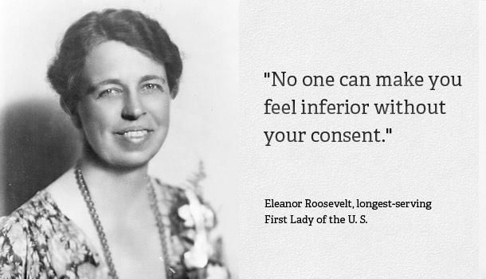
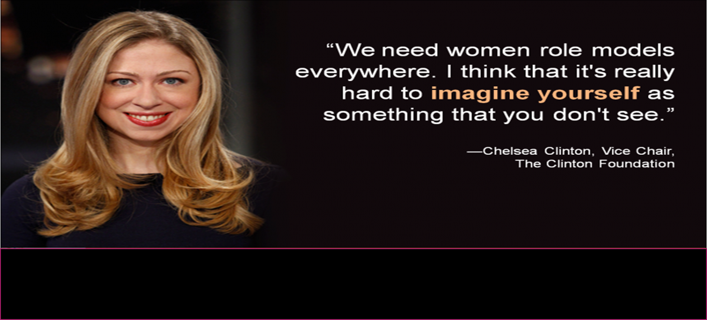

Slide 32
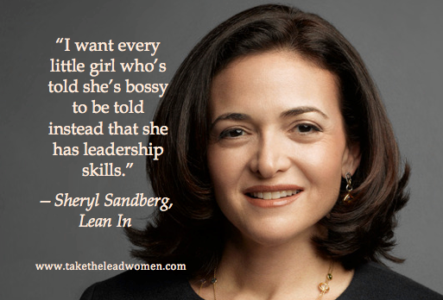

Slide 33
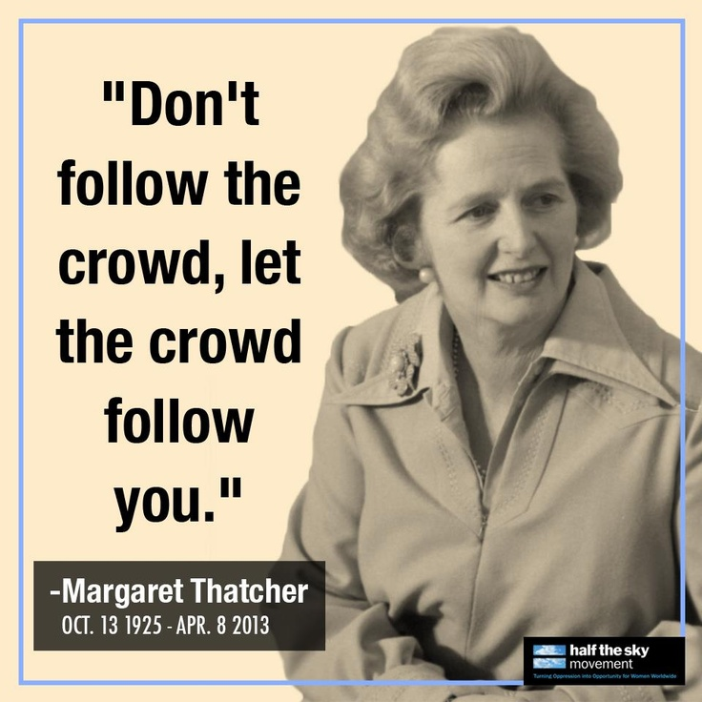

Slide 34
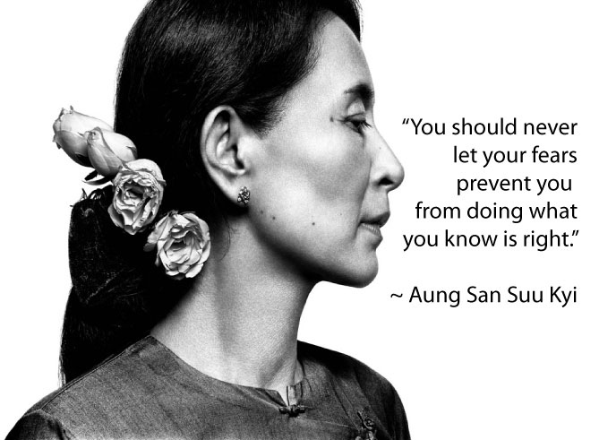

Slide 35
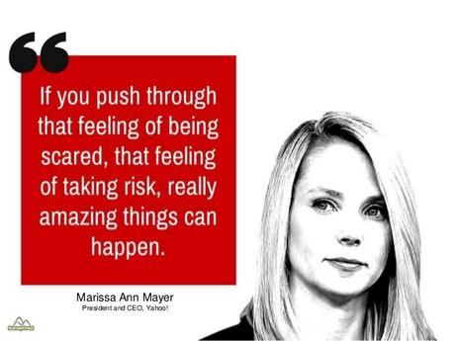

Slide 36
“Know yourself well and just do what you have to do”
Nehal El naggar

Slide 37
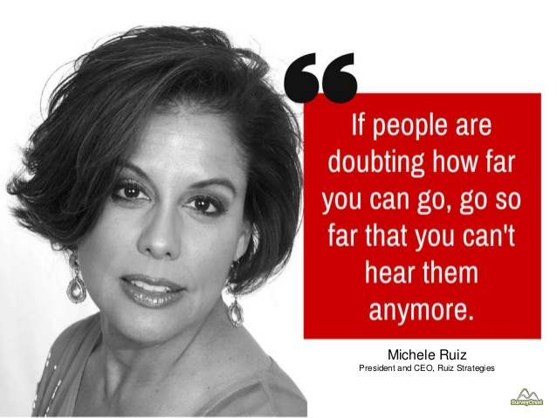

Slide 38
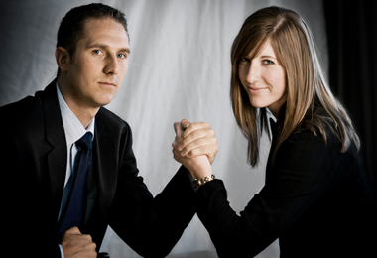
What Do You See in This?

Slide 39
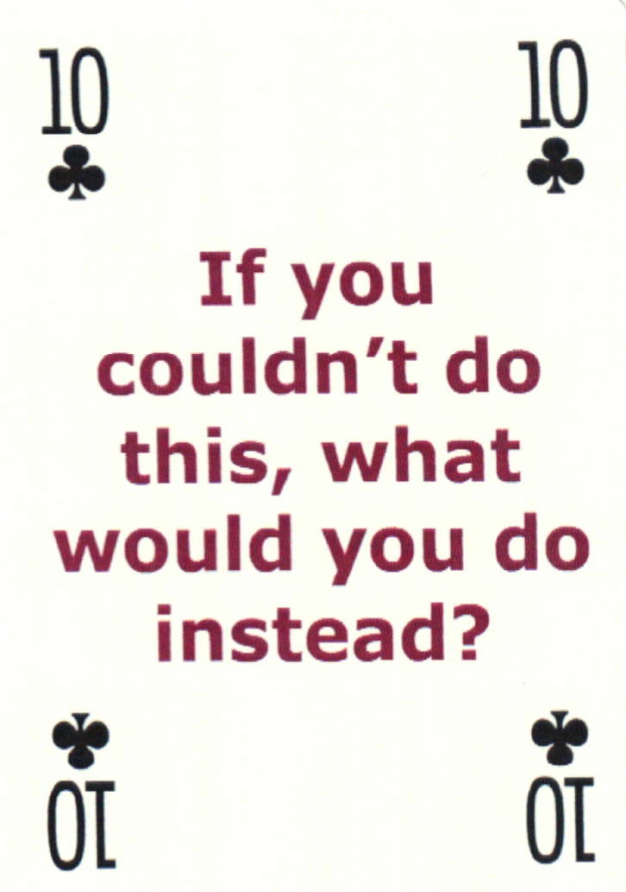


Let’s Get Some Fun!

Slide 40
Thank You

Slide 41


Slide 42


Slide 43


Slide 44


Slide 46
Conclusion

Slide 47
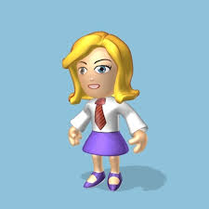

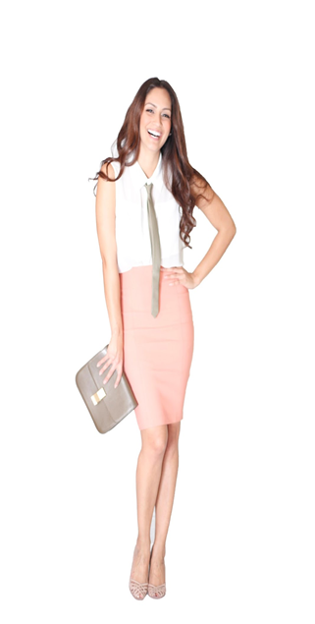
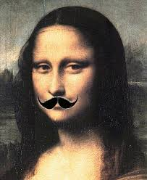
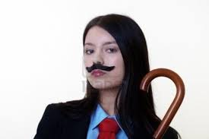
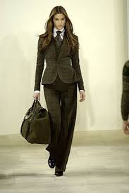

Slide 48
Recommendations

Slide 49
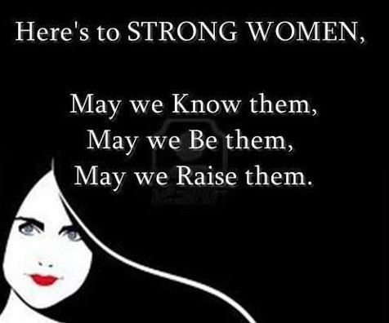

Slide 50
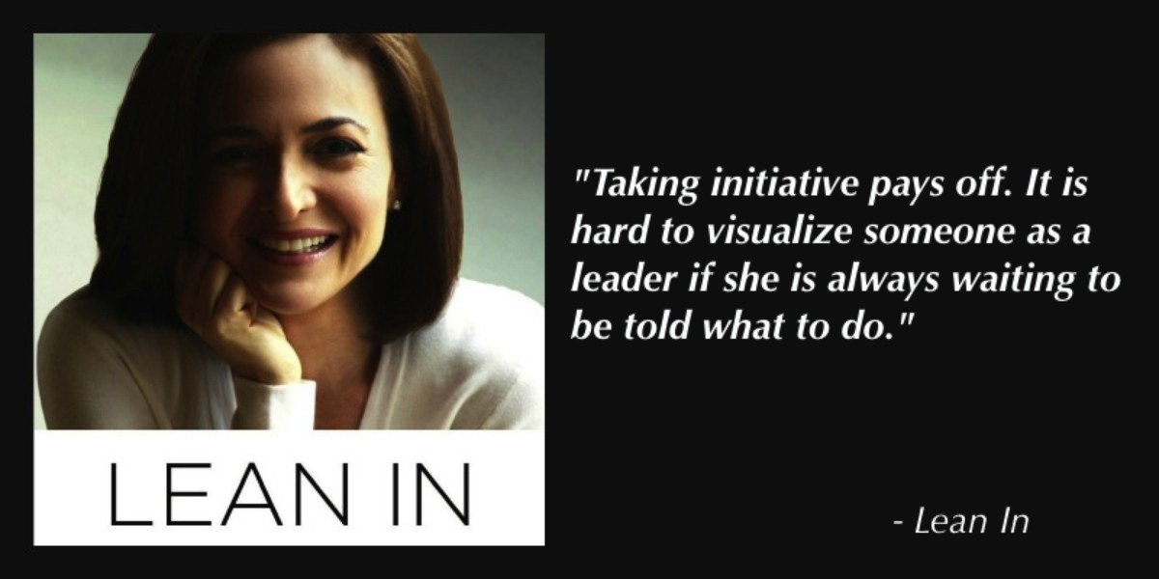

Slide 51
